Slide 1
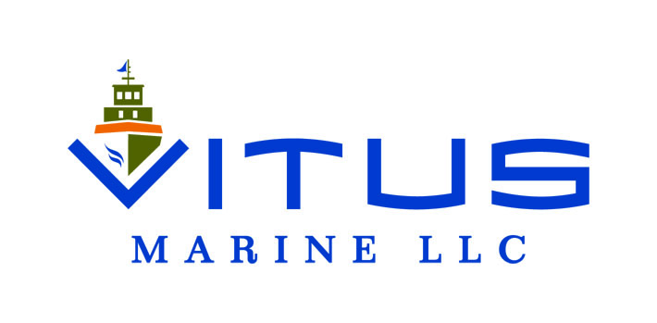
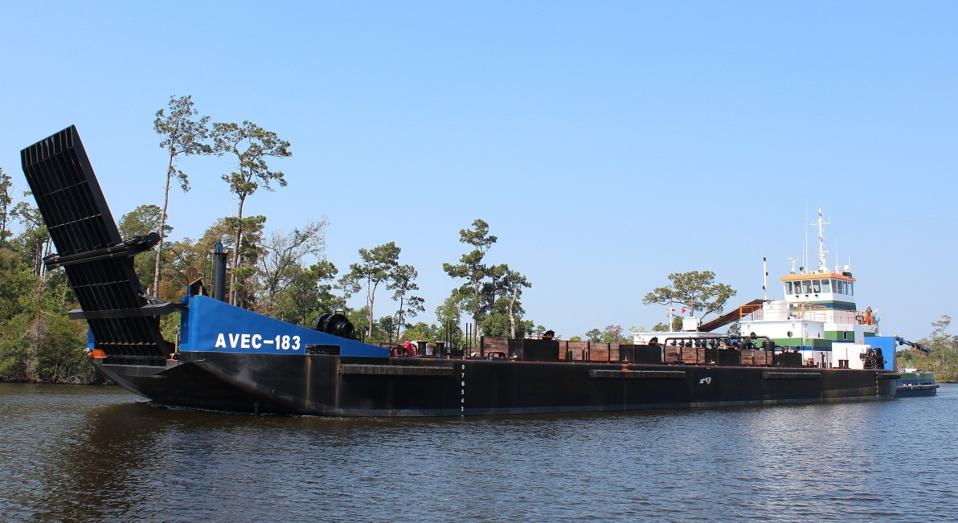
VITUS MARINE LLC OPERATING ENVIRONMENT

Slide 2
Western Alaska Coastal Waters
Tributary Rivers
Lakes, Bays & Sounds
Open Ocean
Few Aids to Navigation
Severe Weather
Few Ports or Harbors
Ice…..Lots of it

Slide 3
Tidal Influences Rarely ‘By the Book’
Silt and Sand Dynamics Pervasive
Coastal Shallows Extend for Miles
Currents & Tides Influenced by Winds
Unimproved Beach Landings
Limited Coast Guard Presence

Slide 4
Marked Annual changes
6 Months Open
27’ of Tidal Range
1200-1400 Salmon Drift Permits
Hundreds of Set Gill Net Skiffs
Hundreds of Seafood Support Vessels

Slide 5
Manokotak Routes
Igushik River 55 NM (22)
Snake/ Weary River 12 NM
Uncharted Rocks
Tidal for Entire Route
235’ & 525’ River Width
~2M lbs of Freight & Fuel

Slide 6
Wood River Special Harvest District
1-3 M Salmon in Transit
>300 Vessels
225’ and 150’ Gill Net @
Uncharted Rocks Upper End
Home-Made NAV Aids

Slide 7
Charts used mainly in electronic form
General positioning only
Reference positions for any NAV Aids
Specific navigation done with sounding vessel
Known track lines when available
Tide Tables used for general reference only
Least accurate in shallow areas far from data reference

Slide 8
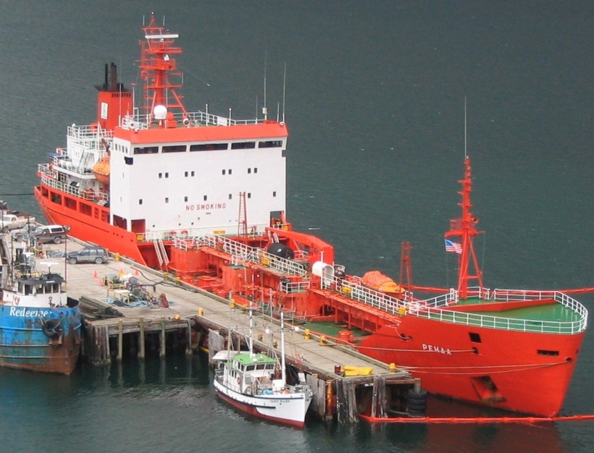
NOME ENERGY SUPPORT

Slide 9
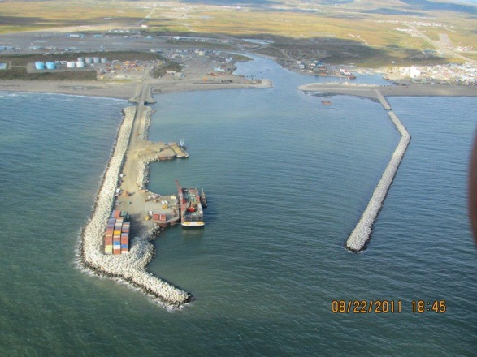
Nov. 18, 2011
News of Bonanza Fuel Inc. (BFI) missing their fall top off of fuel
Missed delivery was scheduled to be the latest fuel delivery to Nome in history
Nov. 29, 2011
Vitus contacted BFI about the missed delivery
Vitus started searching for options

Slide 10
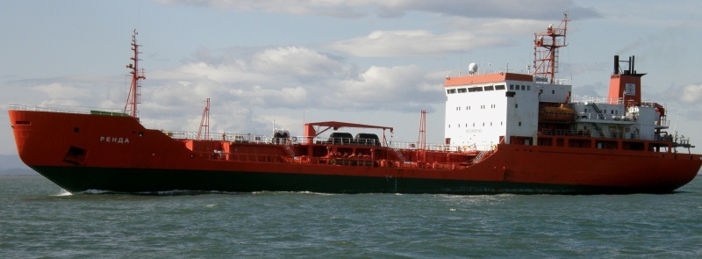
T/V RENDA
35,000 BBL or 1,500,000 gal. capacity
Ice Classed
Renovated in 2010 to a double hull
Previous US Voyages
Knowledgeable Owners
Immediately Available

Slide 11
By early December
Draft Supply Contract in front of Sitnasuak (BFI)
USCG, Alaska Marine Pilots, ADEC, etc., approached prior to contract execution
By Mid-December
Renda was on Charter to Vitus Marine
Planned routing:
Vladivostok to loading point (Korea & Japan) to Nome

Slide 12
Initial Plan:
Vladivostok to Yeosu, Korea – load ULSD#1
Then to Japan to load UNL Gas
Renda too small to dock in Japan
Lighterage barge reserved
Large storm in Sea of Japan, 4-5 days delay.
Jones Act waiver requested & APPROVED
Renda Arrived in Dutch Harbor Early January
Load UNL Gas in Dutch Harbor
Then on to Nome

Slide 14
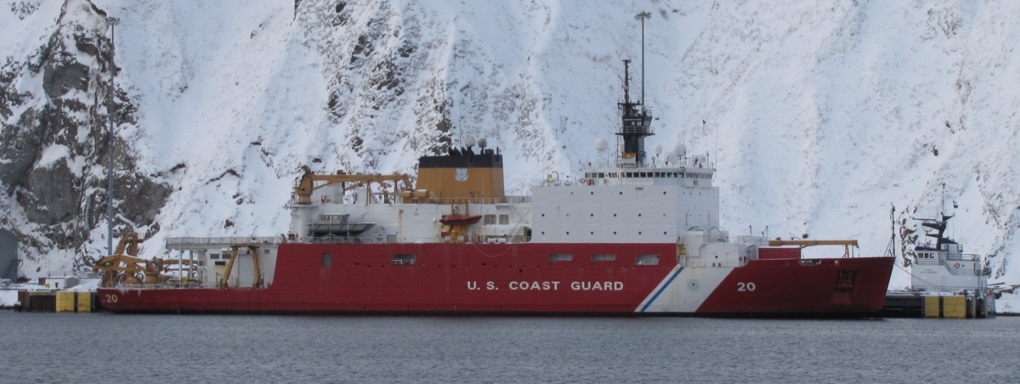
Why did the USCG help?
Semper Paratus – “Always Ready”
USCG Mission: “to facilitate commerce”
Qualified staff and resources at the ready.
When asked, they were “Very Excited” to help

Slide 15
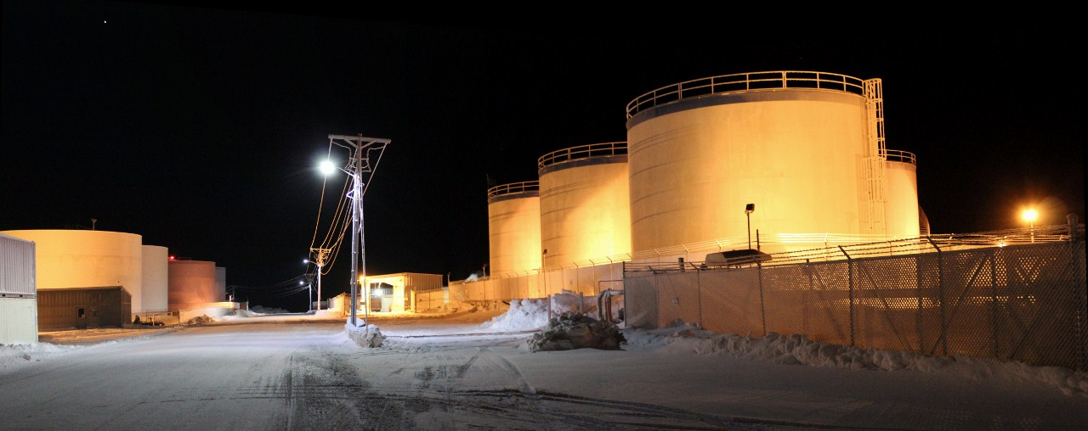
Was all of this really necessary?
Not immediately
ADEC inventoried all bulk storage in Nome – Not enough to last the winter. Run-out in March
Initial discussions were of Flying the necessary fuel & gas in
BFI wanted to give Vitus Marine a shot knowing that the resupply by air option was always there & ready

Slide 16
Biggest Challenges:
VERY HIGH PROFILE – Safety & Prevention
VERY COLD Winter & wind chill
Language Barrier
Vessel Time
Ice Conditions
Ice up to 3 FT thick & ridges 7-10 FT
Expectations
Of the Renda
Of the USCG & Healy

Slide 17
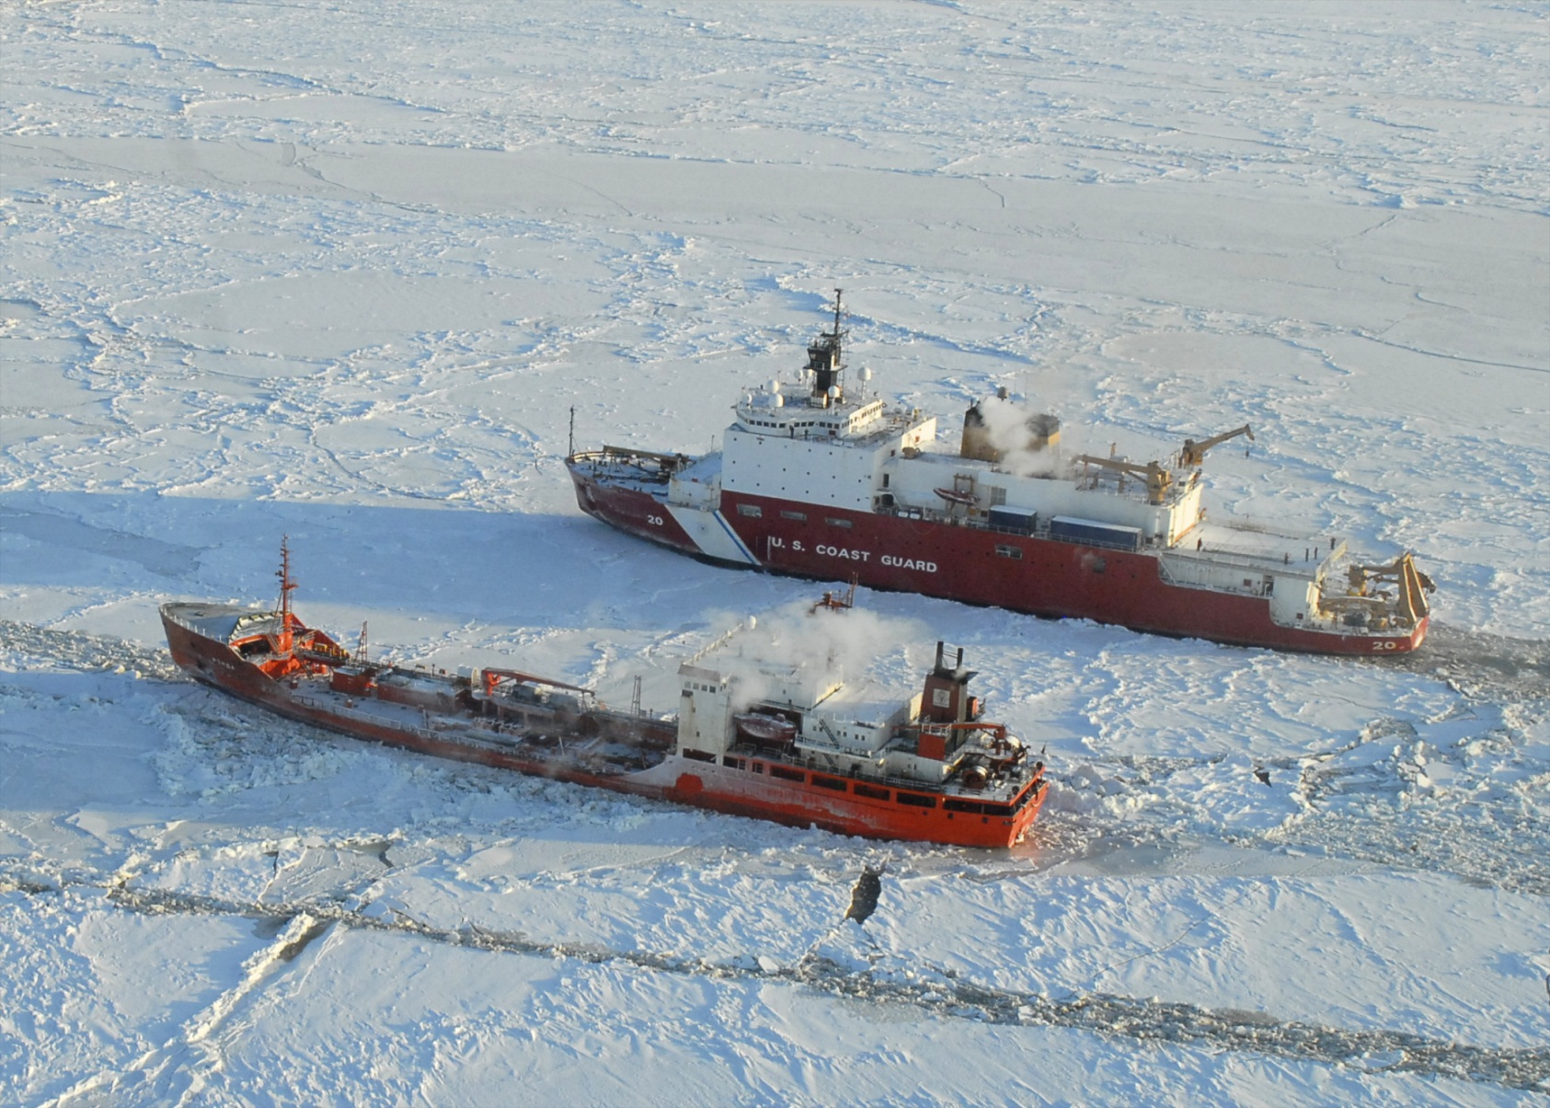

Slide 18
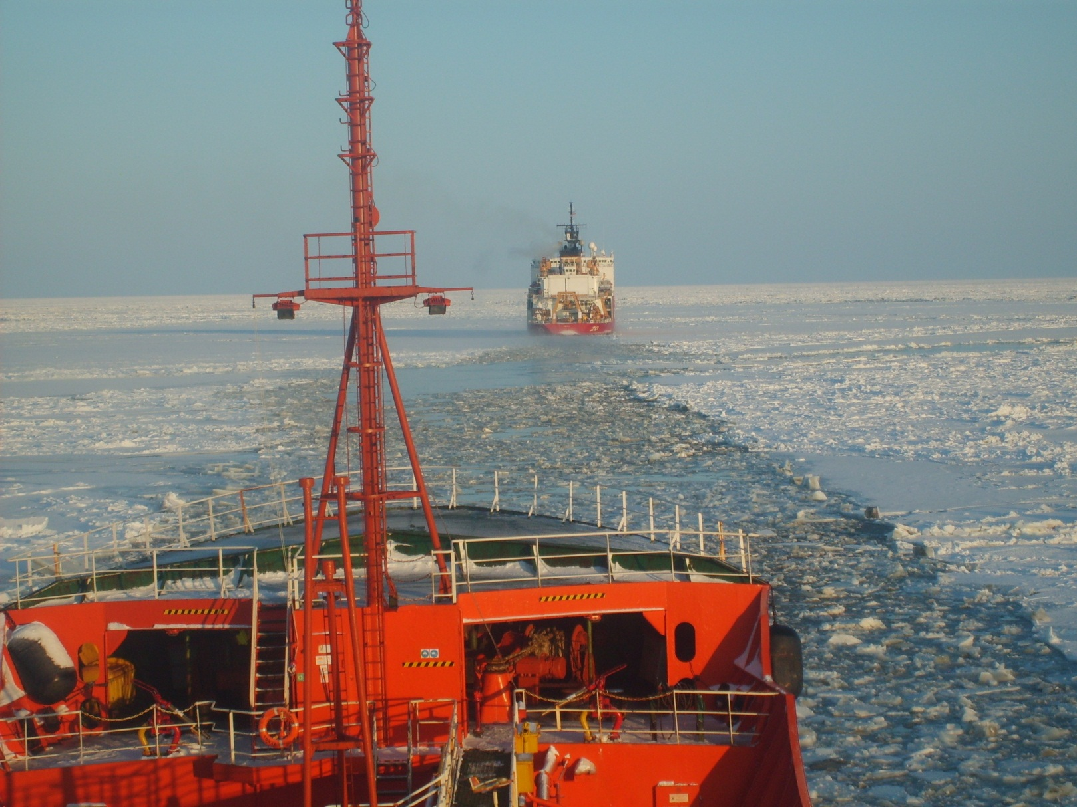

Slide 19
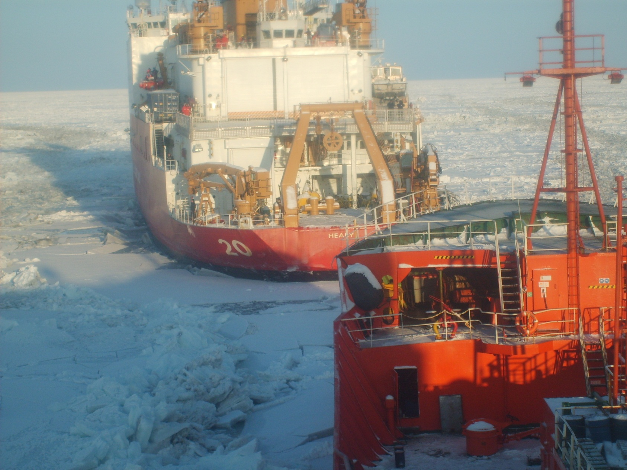

Slide 20
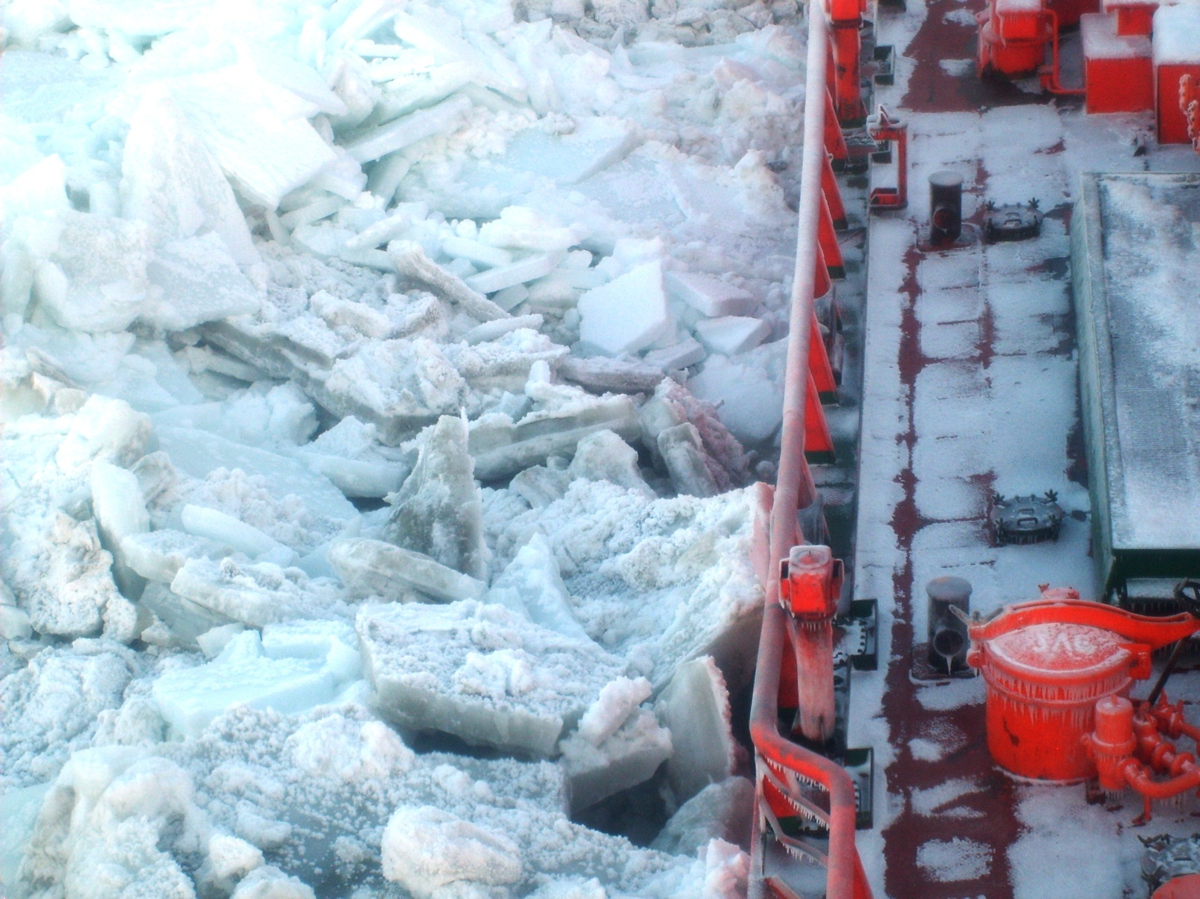

Slide 22
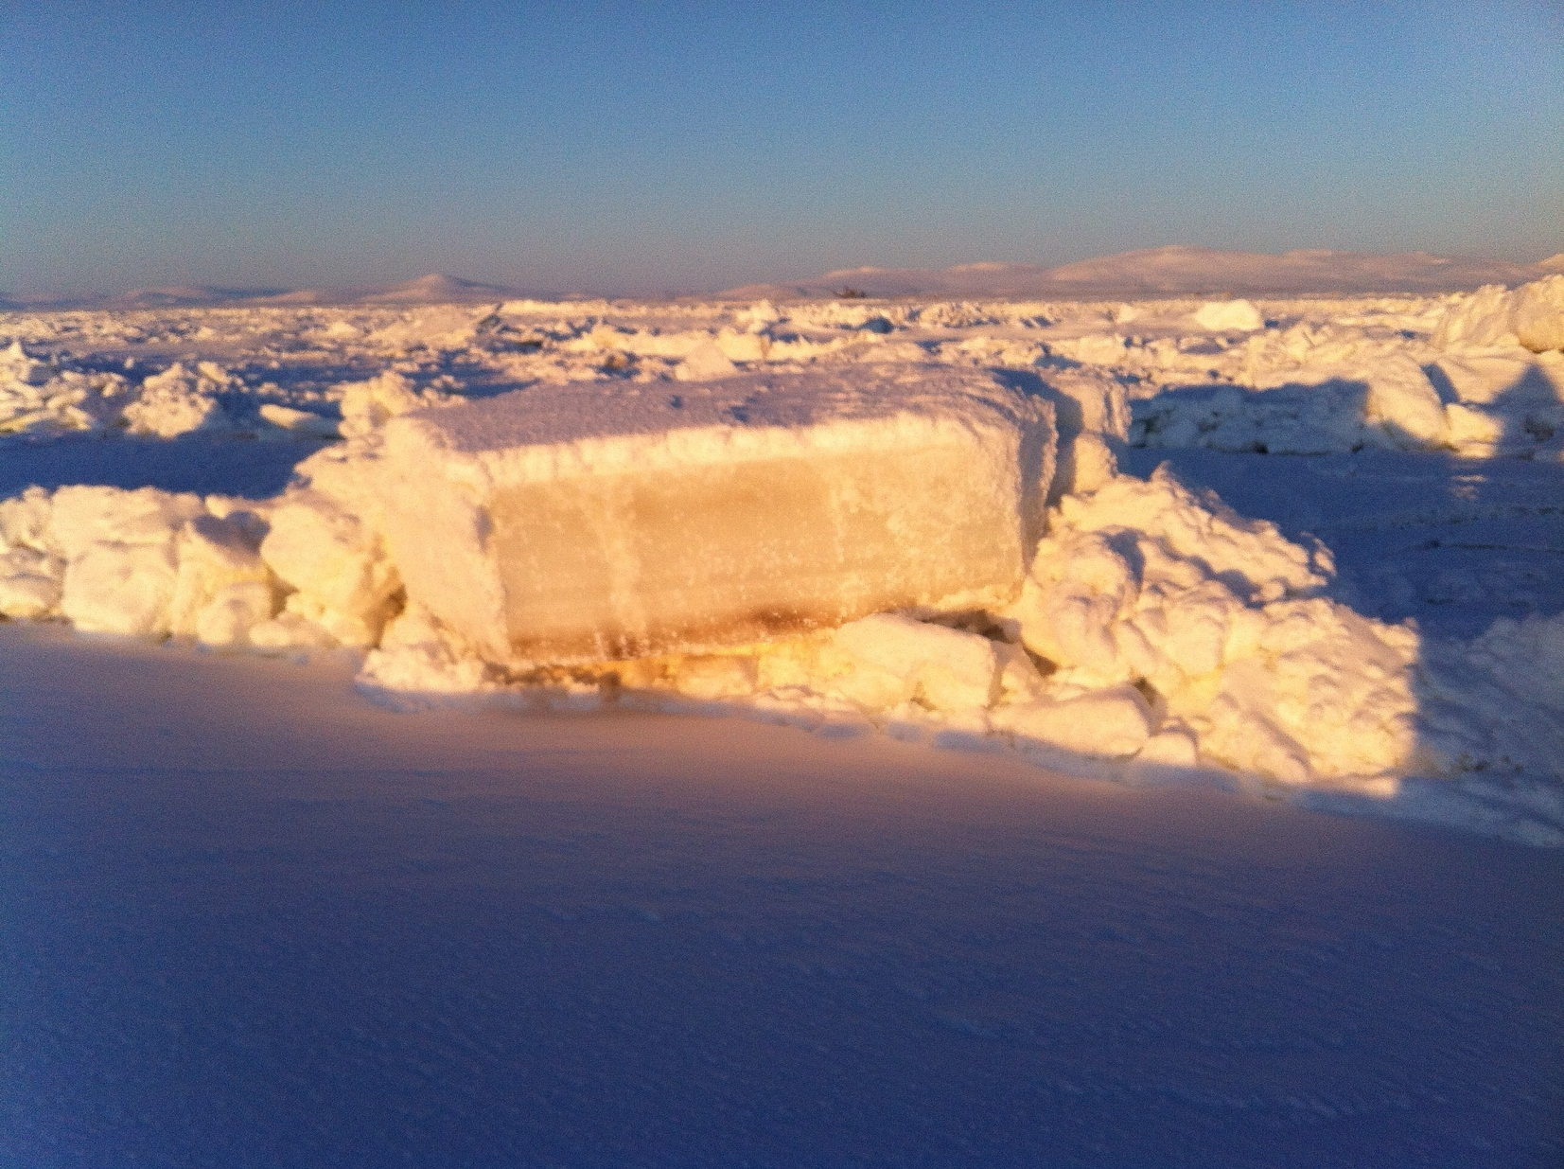

Slide 24
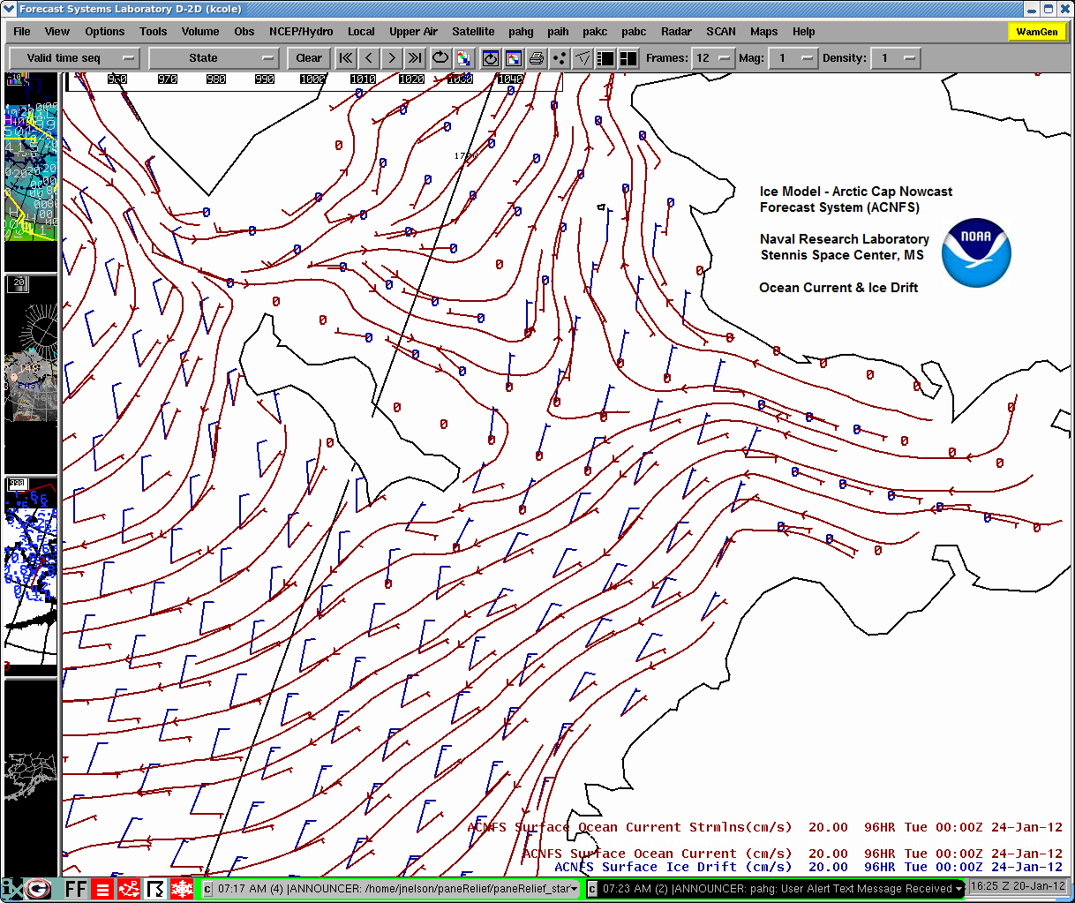
Depth at Breakwater Entrance?
Could the RENDA Break Free Unaided?
Prevailing Currents & Ice Behavior?

Slide 25
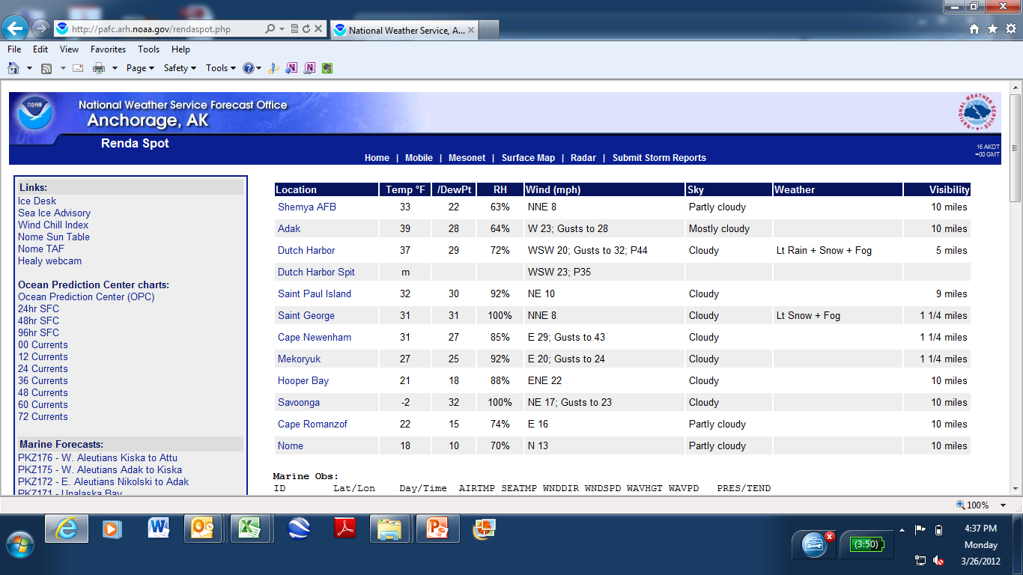

Slide 26
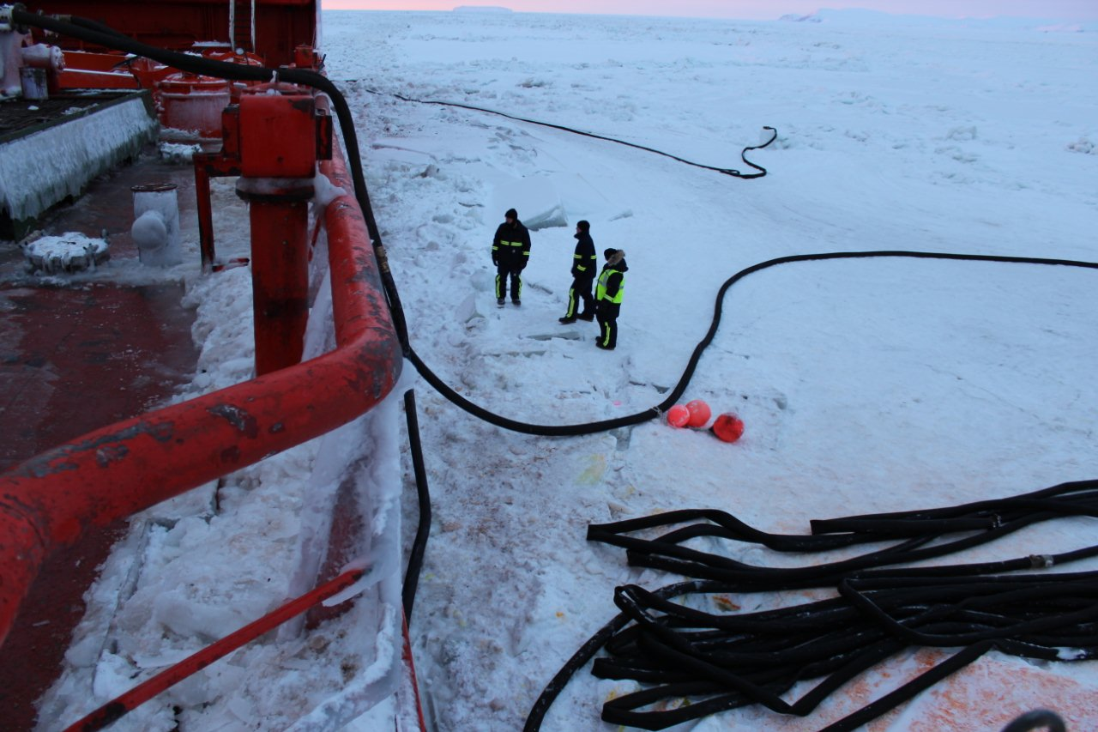

Slide 27
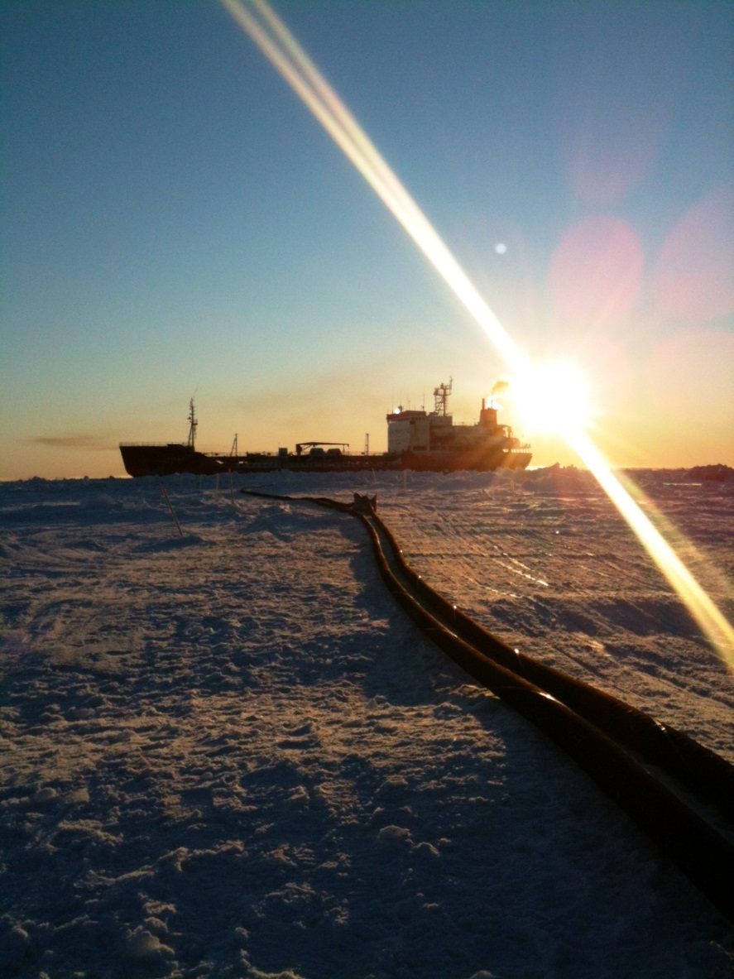
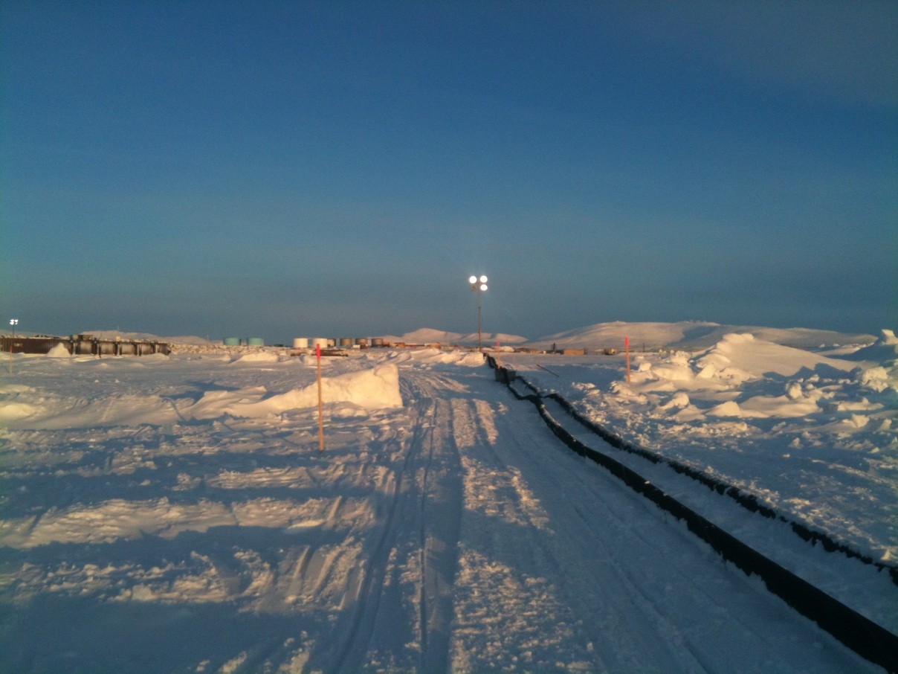

Slide 28
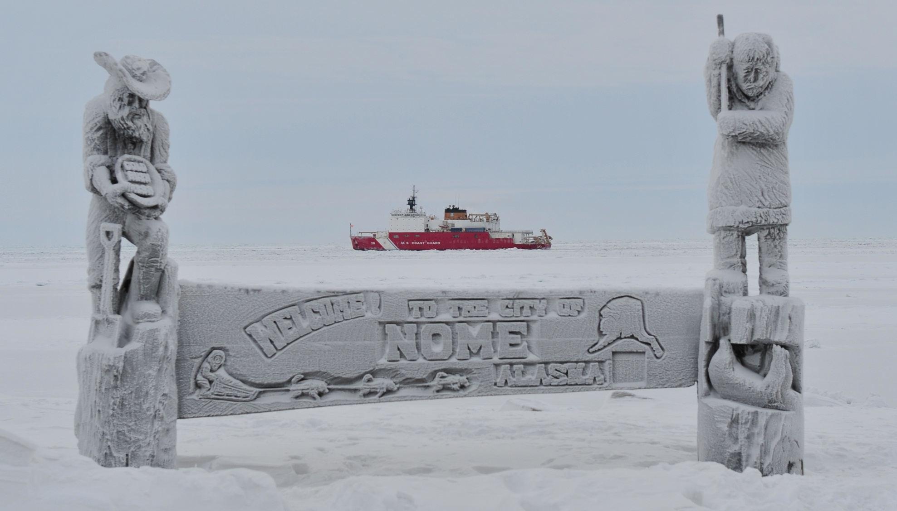

Slide 29
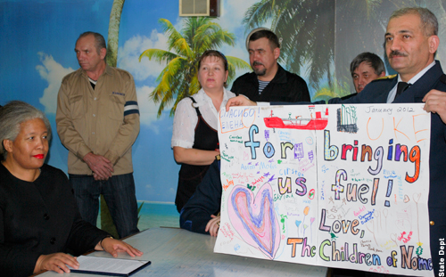
Healy & Renda arrived Nome Jan 14, 2012
LOTS of support and cooperation in Nome
Draft restrictions of the Healy & hose length
Renda unable to get closer under own power
Transfer complete – just over 40 hours
Healy & Renda departed Nome Jan 21
Started the trek south

Slide 30
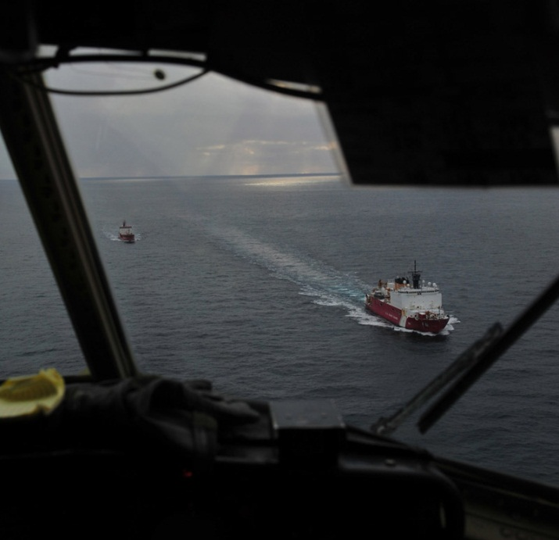
Southbound journey encountered about 100 additional miles of ice
Strong North winds stretched the ice south
By Early February Healy was in open water headed to Seattle & Renda to Vladivostok.
Renda off charter on Feb 11.

Slide 31
A very special thank you to:
Alaska Chadux Corp.
Alaska Marine Pilots (Peter Garay)
Alaska Maritime Agencies
Astra Oil Company
Aurora Hotel, Stampede Enterprise
Bauer, Moyhnihan, Johnson
BNP Paribas
Intertek Caleb Brett
Maritime Affairs Consultant – Jeffrey Garret
NOAA Alaska Region Weather Forecasters
NOAA Sea Ice Program Director Kathleen Cole
City of Nome
Pacific Fishing Assets
RIMSCO
RS Platou Borge Steinsvik
Sitnasuak & Bonanza Fuels Team Members
Storm Force Services
United States Coast Guard
University of Alaska Fairbanks – Greg Walker & Dr. Andy Mahoney

Slide 33
Q & A

